Slide 1


Slide 2

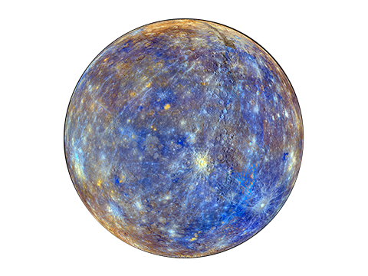
Mercury
An Intelligent Banking Risk-Management System
Based on Fintech
Southwestern University of Finance and Economics

Slide 3
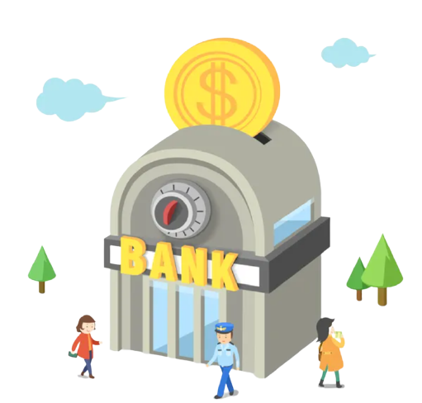
July 23rd. 2021
Bank of SWUFE

Slide 4
The Credit Department …

Slide 5
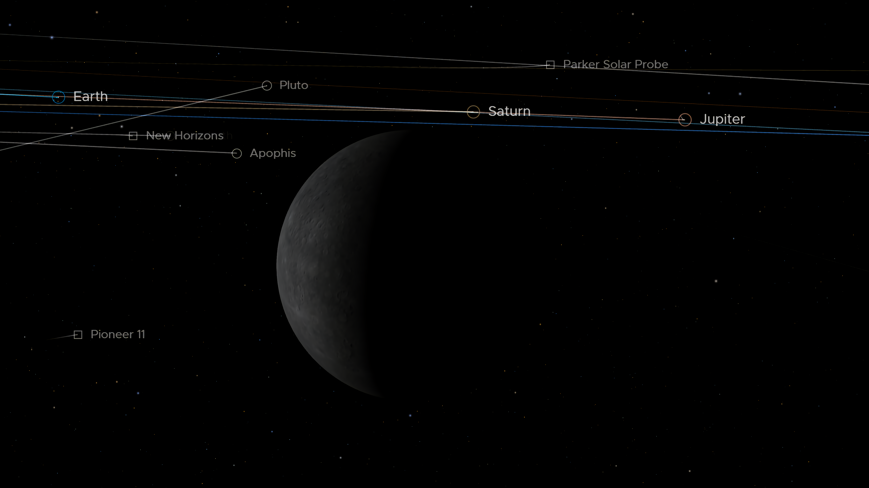


Commerce
Risk
Fraud
Mercury

Slide 6


Current Situation of the Loan Market
- Pain points of traditional banks
Complex and time-consuming credit investigation
Adverse selection of loan interest rates and terms
Hard to detect risk connections based on industry and geography
Difficult to track company credits after the loan origination
Notes:
（1）传统银行痛点
信息不对称造成贷款利率和期限的逆向选择
贷款公司风险审查流程复杂，费时费力
难以察觉公司风险之间的联系
难以从行业和地域视角对公司风险有宏观认识

Slide 7
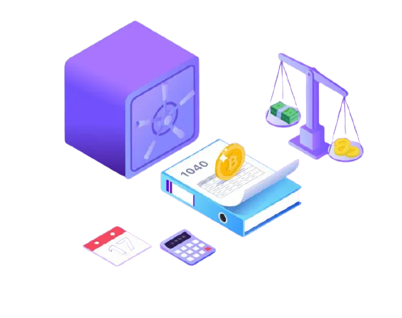
Product Functions
Risk associations identification
Loan interest rates and terms suggestions based on risks
Comprehensive real-time
loan risk monitoring
Dynamic track of risk changes
Notes:
1.全面实时贷款风险监控
2.根据风险提供利率、期限决策
3.识别风险关联
4.持续追踪风险动态变化

Slide 8
How Mercury Works?
Data Resources
Web
Server
Web
Crawling
Client
Side
DB Server
Data
Purchase
(API)
Middleware Server
User
Behaviors
Model Server
··· ···
Notes:
1.全面实时贷款风险监控
2.根据风险提供利率、期限决策
3.识别风险关联
4.持续追踪风险动态变化

Slide 9
How Mercury Works?
Data Resources
Web
Server
Web
Crawling
Client
Side
DB Server
Data
Purchase
(API)
Middleware Server
User
Behaviors
Model Server
··· ···
Notes:
1.全面实时贷款风险监控
2.根据风险提供利率、期限决策
3.识别风险关联
4.持续追踪风险动态变化

Slide 10
Algorithm Logic
- Learn from the Past
137
15
230k+
17%
Attributes
Sources
Records
Labels

Slide 11




Algorithm Logic
- Feature Engineering
Quick Ratio
Asset / Liability
Income Growth
Asset Rank
Government Subsidy
Government Honors
Employee Growth
Employee Welfare
Asset / Liability Ratio
Income Growth Rate
Government Subsidy
✘
✔
Risk
Risk
✘
Risk
Normal
✔
Risk
✘
✔

Slide 12

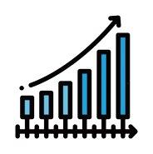



Algorithm Logic
- Problem 1: Feature Interaction
Income vs. Subsidy
Income vs. Tax
✔
✔
Risk
Risk
Risk
Risk
Risk
Risk
Normal
Normal
Risk
Risk
✔
✔

Slide 13






Algorithm Logic
- Solution: Tensor Multiplication
$$𝒲$$
$$h_{i}$$
$$x_{acc}$$
$x_{hum}$
$$𝒯^{[1:k]}$$
$h_{i}=x_{acc}𝒯^{[1:k]}$ $x_{hum}$ + [$x_{acc}$ || $x_{hum}]𝒲+b$

Slide 14
Algorithm Logic
- Problem 2: Risk Propagation

Slide 15
Algorithm Logic
- Problem 2: Risk Propagation
- Graph Attention Network

Slide 16




Algorithm Logic
- Graph Attention Network: Relation Inferring
$$h_{i}$$
$$e_{j,i}$$
$=α^{Τ}$[$h_{i}$||$h_{j}]𝒲$
$$h_{j}$$

Slide 17








Algorithm Logic
- Graph Attention Network: Information Propagation
$$h_{0}$$
$$e_{0,i}$$
$$=σ(\sum_{K}{{e_{k,i}h}_{k})}$$
$$s_{i}$$
$$h_{1}$$
$$e_{1,i}$$
$$h_{2}$$
$$e_{2,i}$$

Slide 18
Algorithm Logic
- Graph Attention Network

Slide 19



Algorithm Logic
- Multi-Relation Network
$$s_{i}^{Industy}$$
$$s_{i}^{Region}$$
$$s_{i}^{Type}$$

Slide 20
Algorithm Logic
- Final Classifier
MLP
Risk
Risk
Risk
Risk

Slide 21

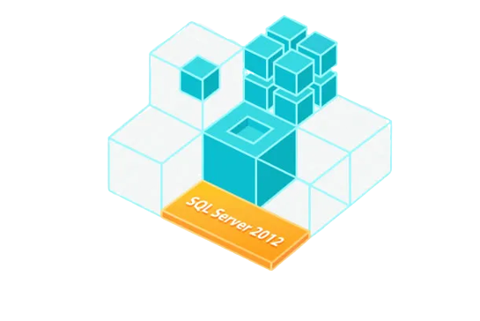

Algorithm Logic
- Workflow: Data Preprocess
Missing Values
Data Preprocess
Outliers
Normalization

Slide 22


Algorithm Logic
- Workflow: Feature Engineering
Feature
Engineering

Slide 23
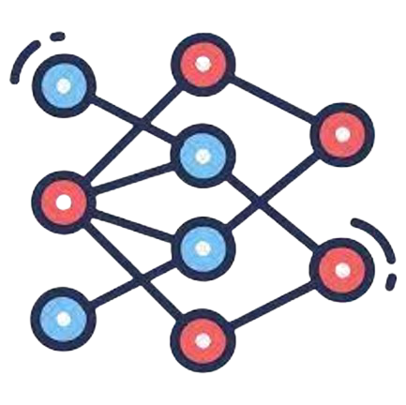



Algorithm Logic
- Workflow: Ensamble
Risk
Risk
Risk
Risk

Slide 24
Algorithm Logic
- Workflow: Overview
Data Preprocess
Missing Values
Feature
Engineering
Outliers
Normalization
Risk
Risk
Risk
Risk

Slide 25
Algorithm Logic
- Comparison

Slide 26
How Mercury Works?
Data Resources
Web
Server
Web
Crawling
Client
Side
DB Server
Data
Purchase
(API)
Middleware Server
User
Behaviors
Model Server
··· ···
Notes:
1.全面实时贷款风险监控
2.根据风险提供利率、期限决策
3.识别风险关联
4.持续追踪风险动态变化

Slide 27
Front-end Logic
Financial Institution
Risk Management
Log in
Dashboard
Risk State of
Corporates
Search Page
Risk Proportion
&
Industry Risk Level

Slide 28
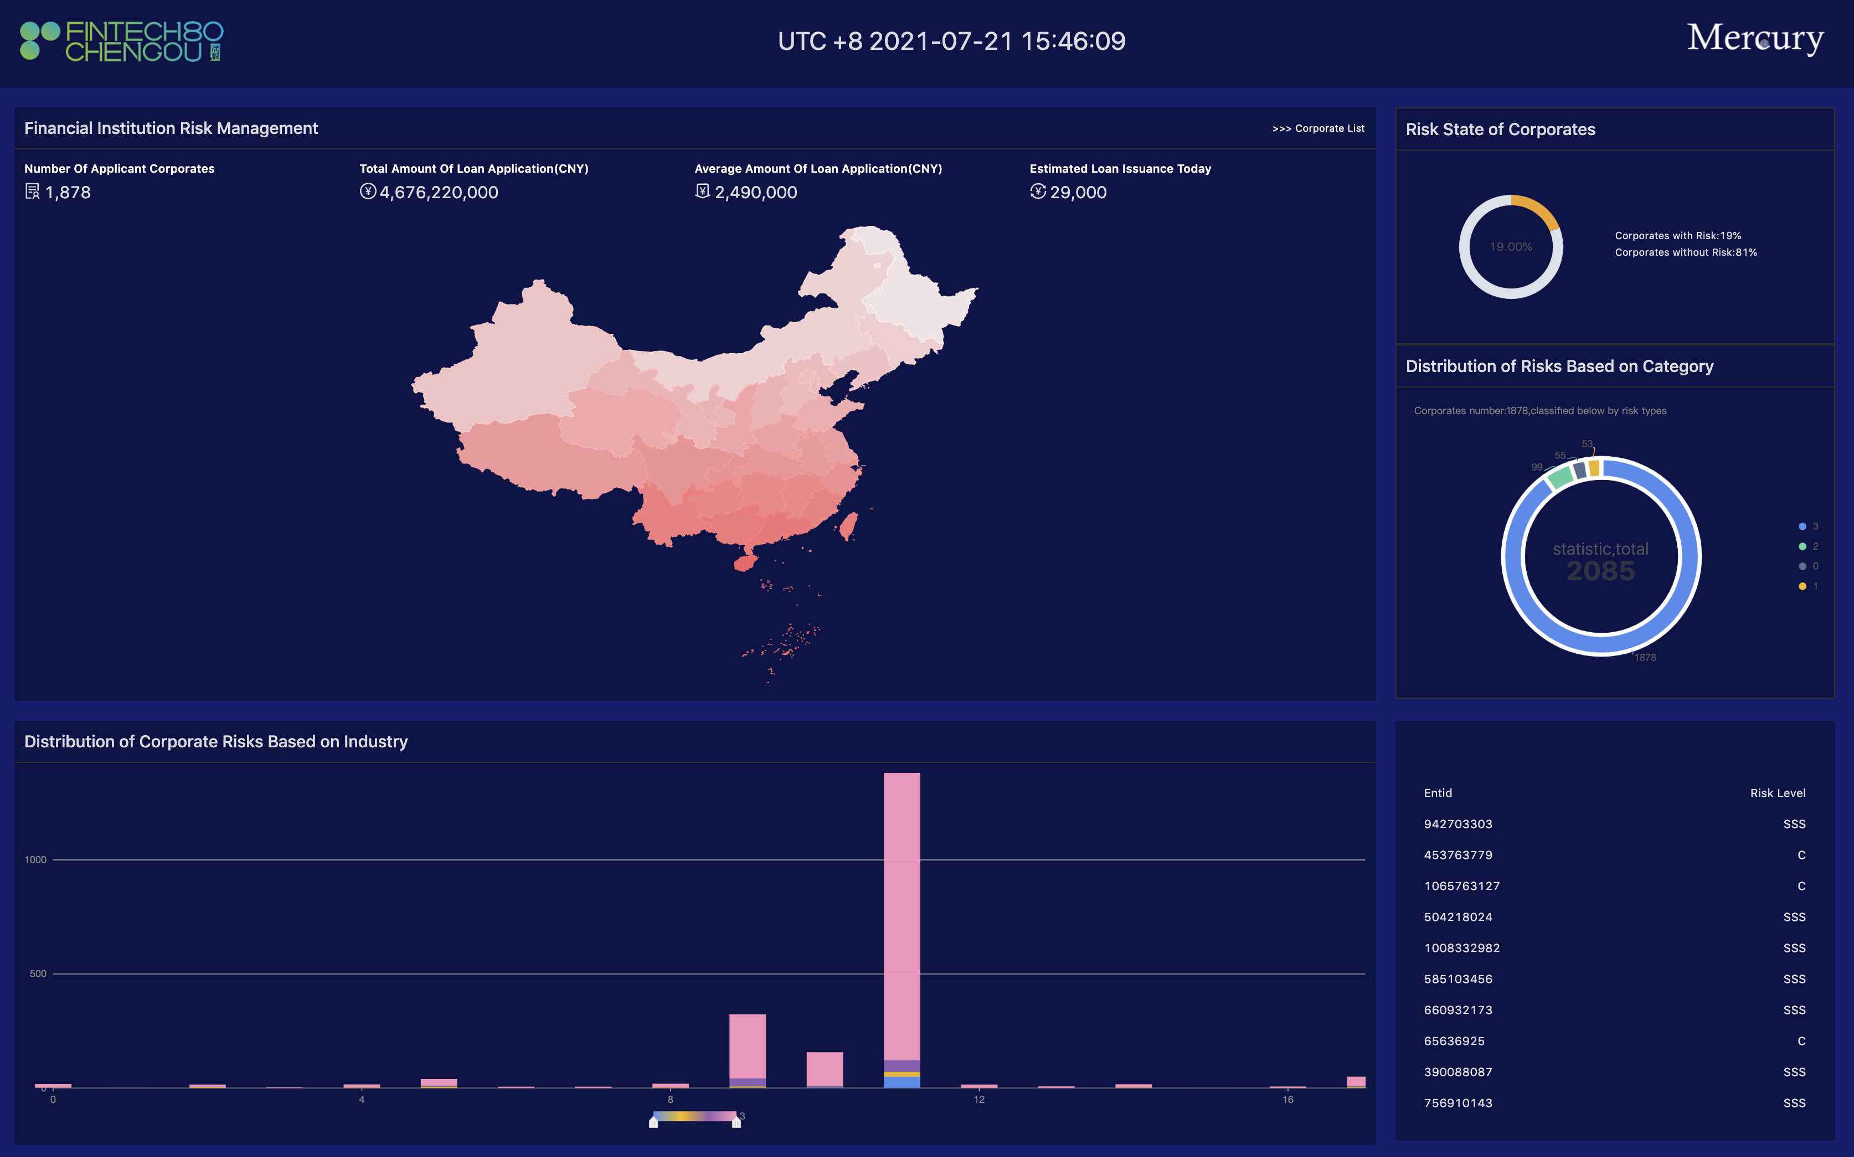
Risk State of
Corporates
Financial Institution
Risk Management
Corporate Risk
Based on Industry and Category

Slide 29
Front-end Logic
Financial Institution
Risk Management
Log in
Dashboard
Risk State of
Corporates
Search Page
Corporate Risk
Based on Industry and Category

Slide 30
Front-end Logic
Corporate List
Corporate
Information
Page
Search Page
Search Function

Slide 31
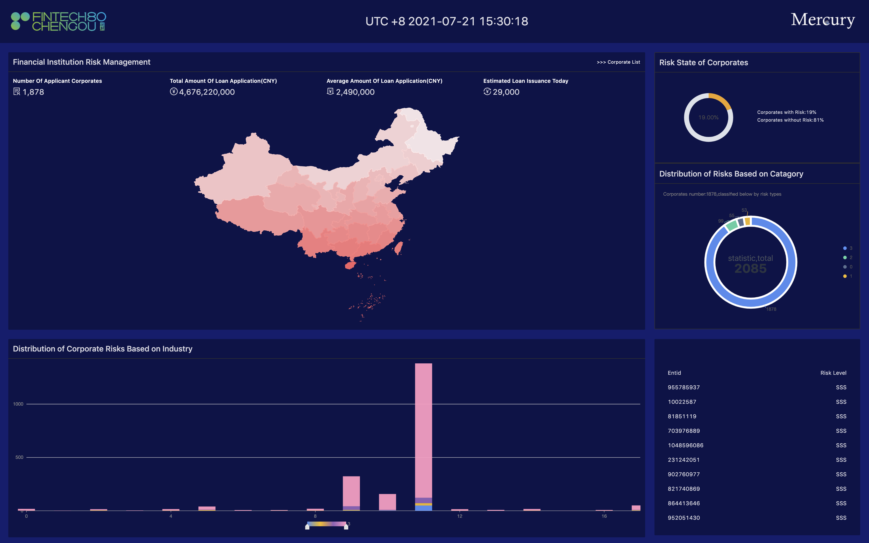
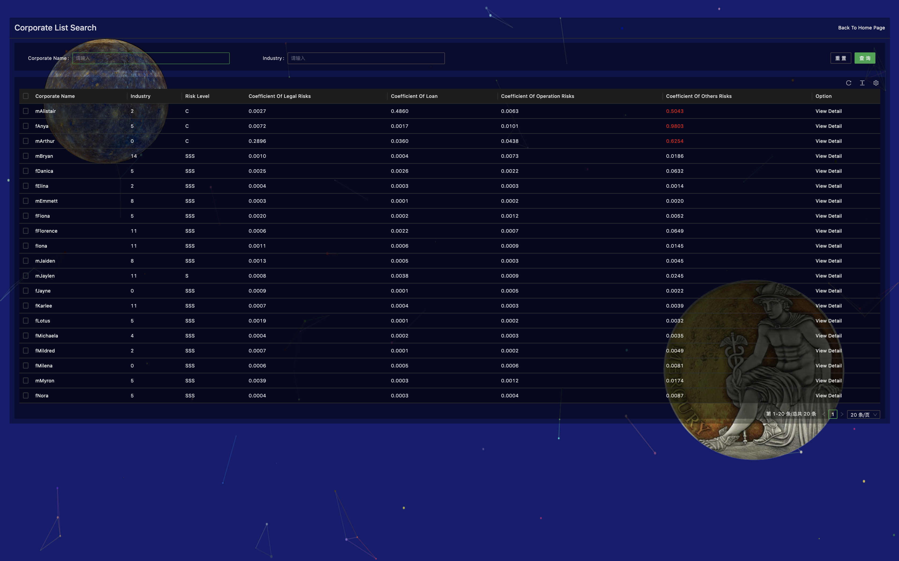
Search Function
Reset
Go
Corporate List

Slide 32
Front-end Logic
Financial Risk Trends
Corporate
Information
Page
Financial Risk Index
Risk Measurement
Risk-Spreading
Path

Slide 33
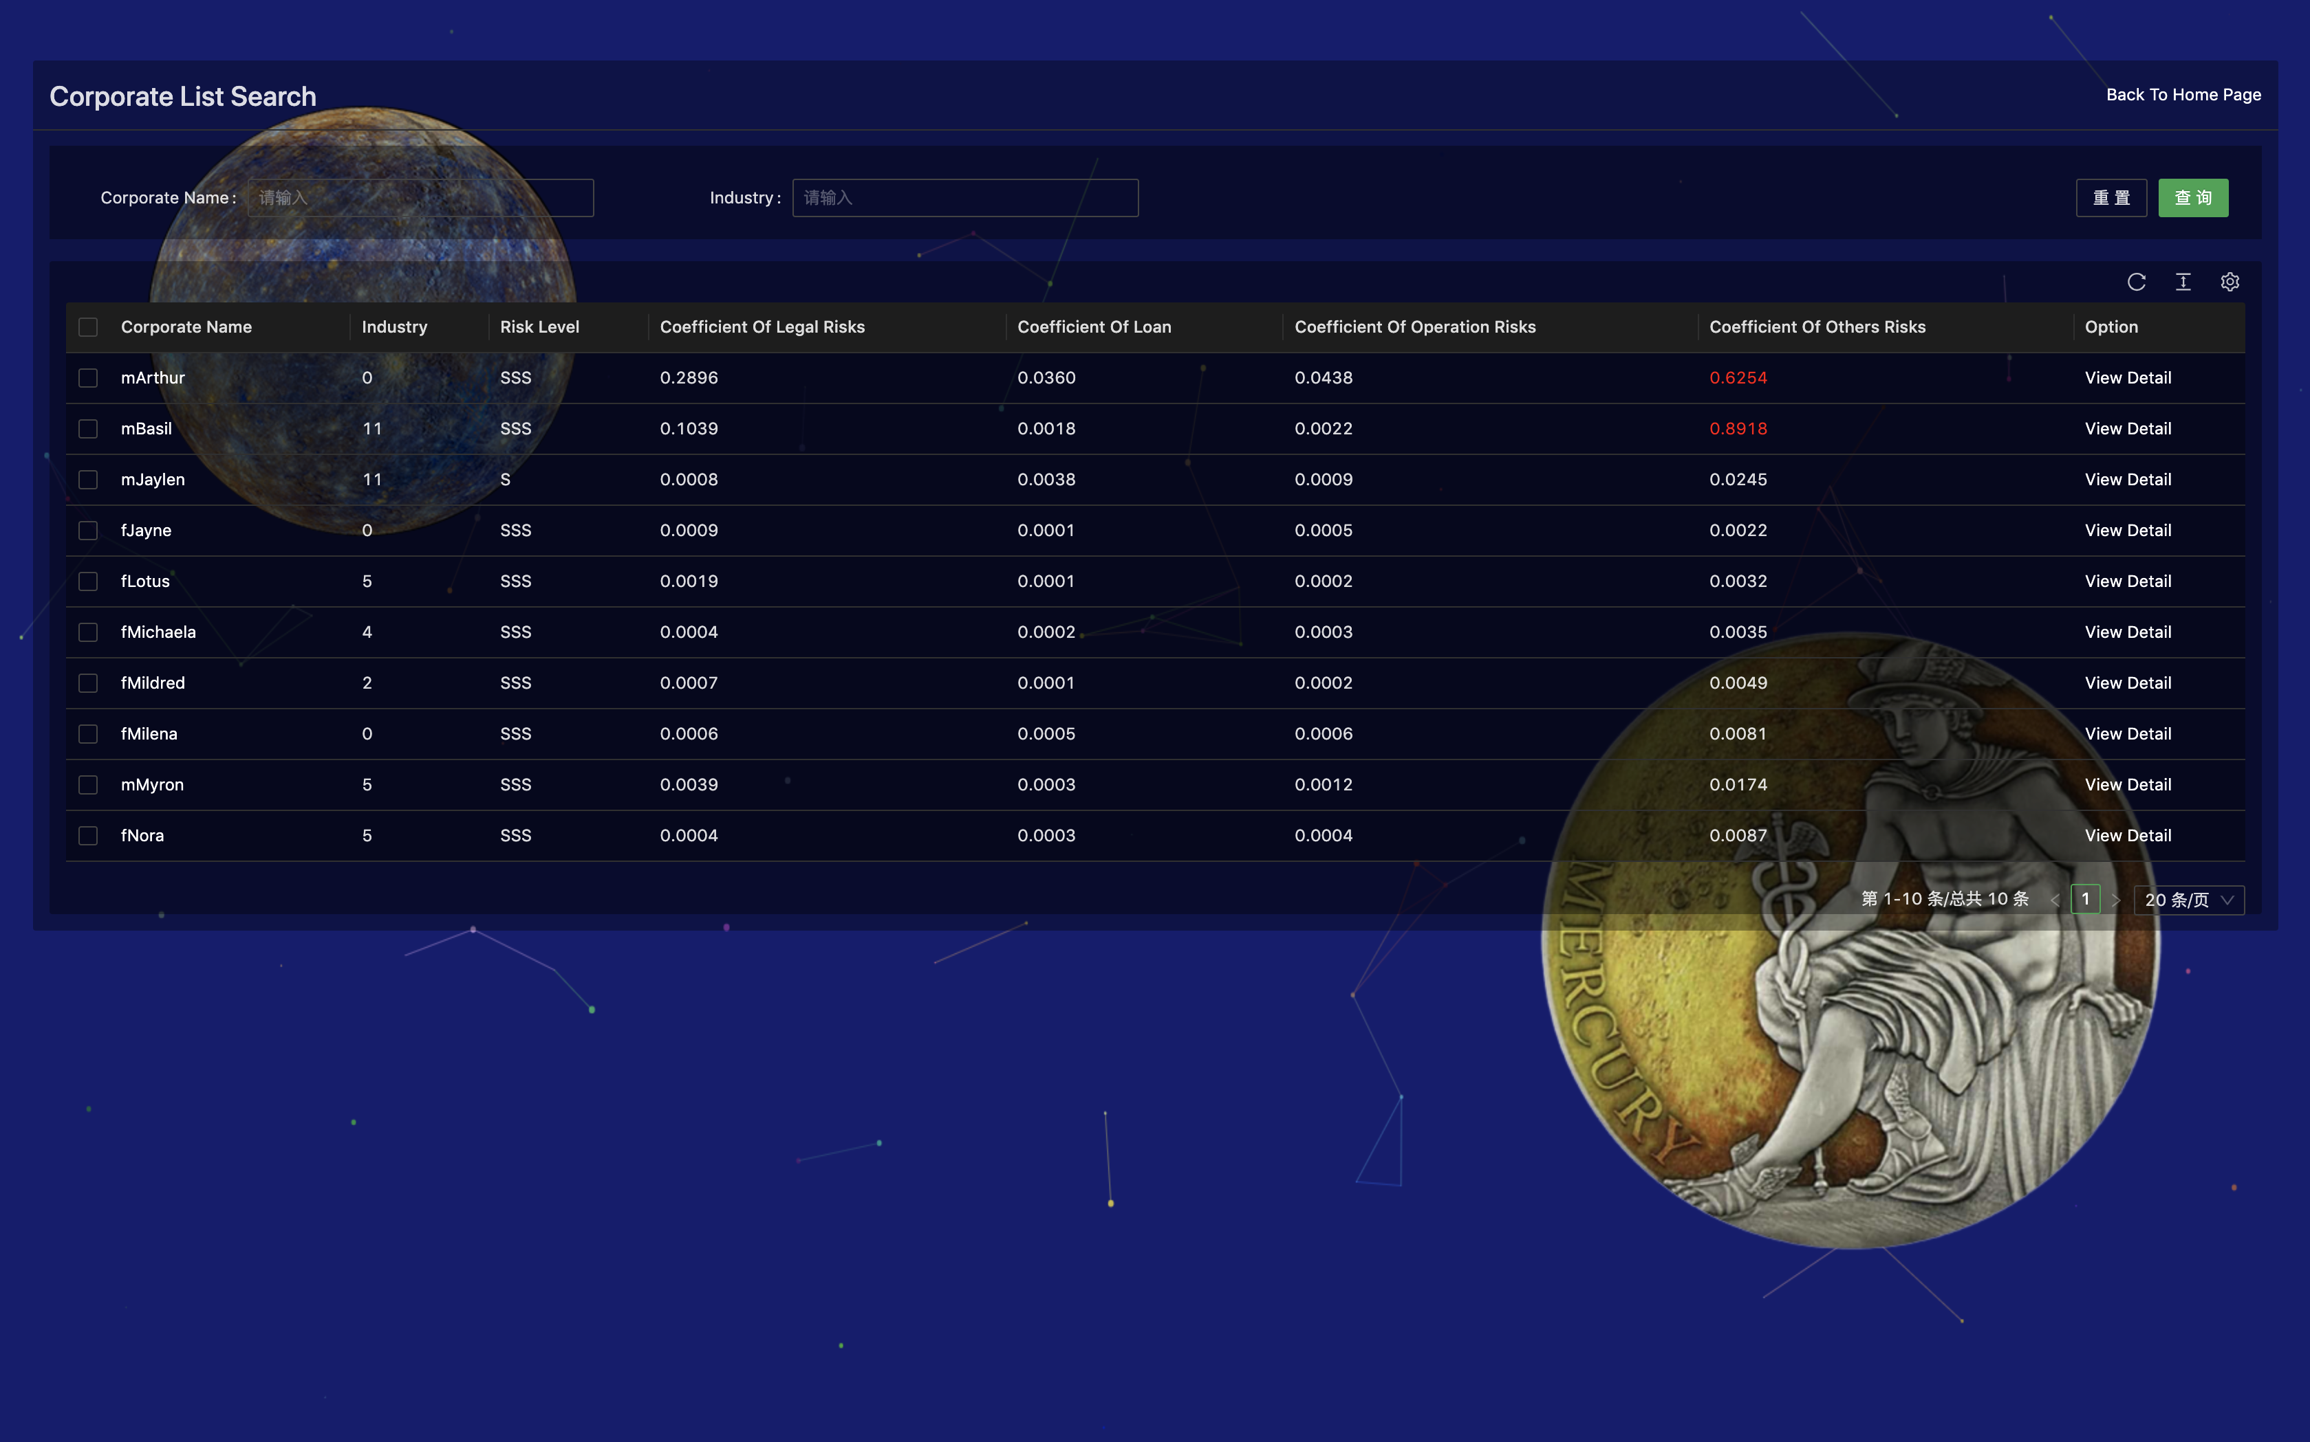
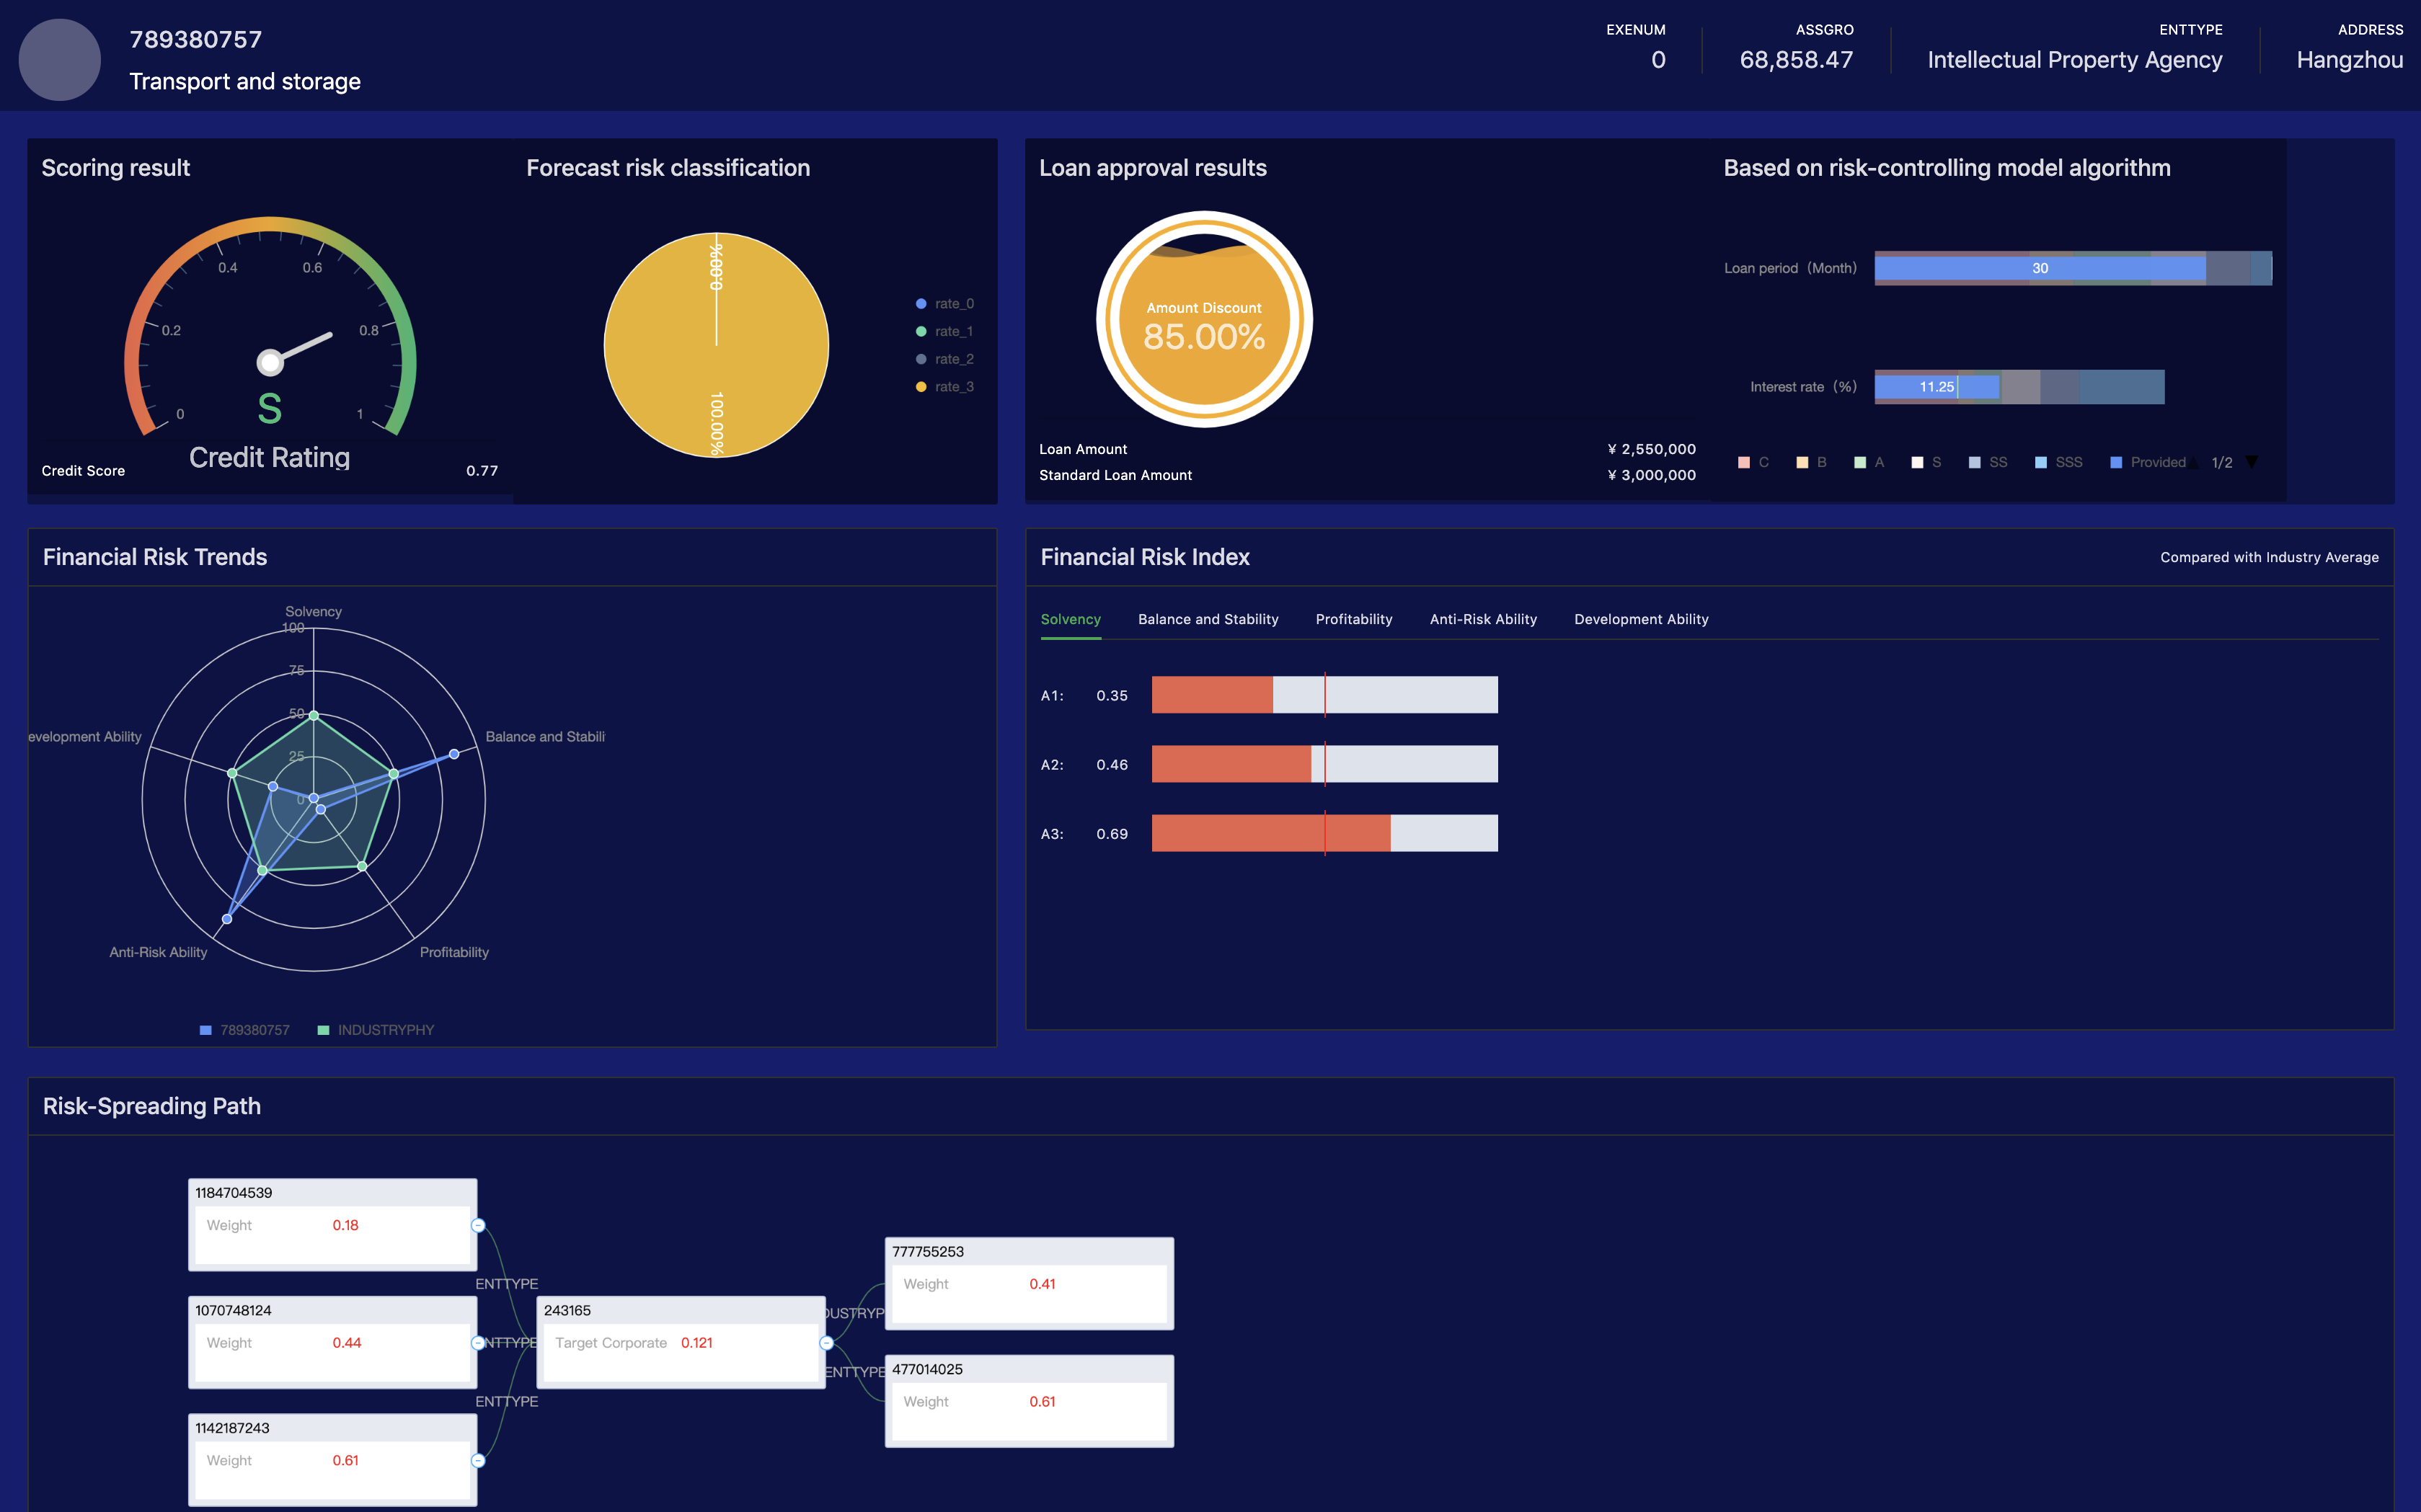
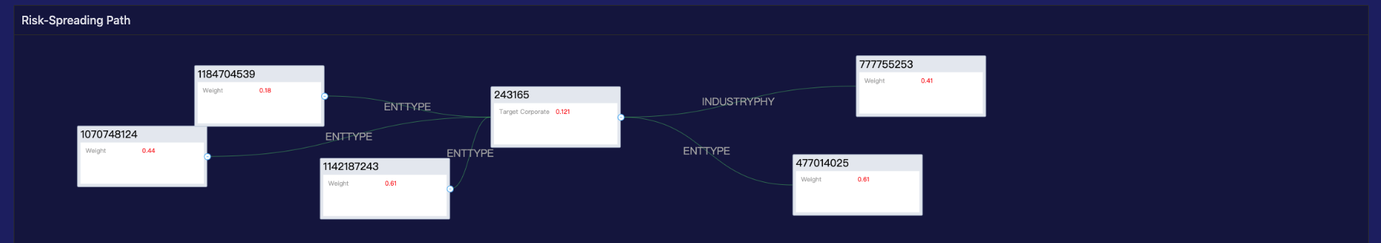
Financial Risk Trends
Financial Risk Index
Risk-Spreading
Path

Slide 34
Front-end Logic
Loan Interest Rate
Loan term
Risk Measurement
Expert Decisions
Loan Approval Result
Loan Limit
Loan Discount

Slide 36
Future Prospects
A timely warning system based on richer time-series data
A more scientific and accurate suggestion via
external audit data, etc.
More abundant sources of data

Slide 37


Thanks
Southwestern University of Finance and Economics

